Slide 1

Digital Image Processing - 1
(UE21EC342AC1)
‘Dehazing of an Image using Dark Channel Prior’
Team Number : 23
Shrihari Narayan Birthur (PES1UG21EC275)
Srinivasa Puranika Bhatta (PES1UG21EC295)
Sumukh Shadakshari (PES1UG21EC302)

Slide 2
CONTENTS
Introduction
Concepts Applied
Demonstration
Results
Conclusion
References

Slide 3
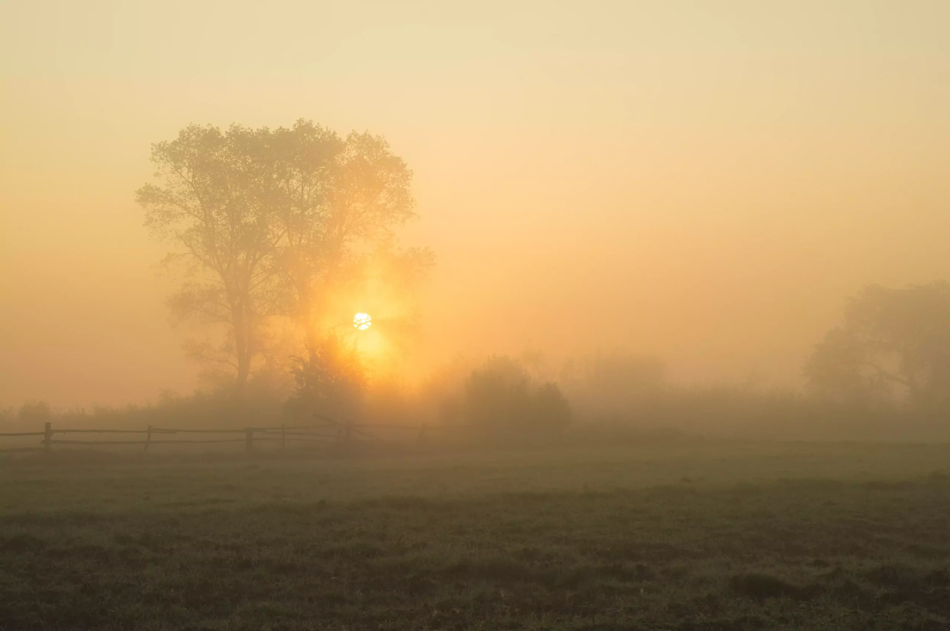
Introduction
Outdoor scenes, in bad weather are usually degraded due to the presence of particles or droplets in the atmosphere. The amount of scattering depends on the distances of the scene points from the camera.
We use Dark Channel Prior which gives us an effective method to estimate the local transmissions for hazy images.

Slide 4
Concepts Used
The formation of a haze image can be represented by the equation:
Where I is the observed hazy image, J is the scene radiance(undegraded image), A is the global atmospheric light, and t is the medium transmission describing the portion of the light that is not scattered and reaches the camera.
The goal here is to recover J, A, and t from I.

Slide 5
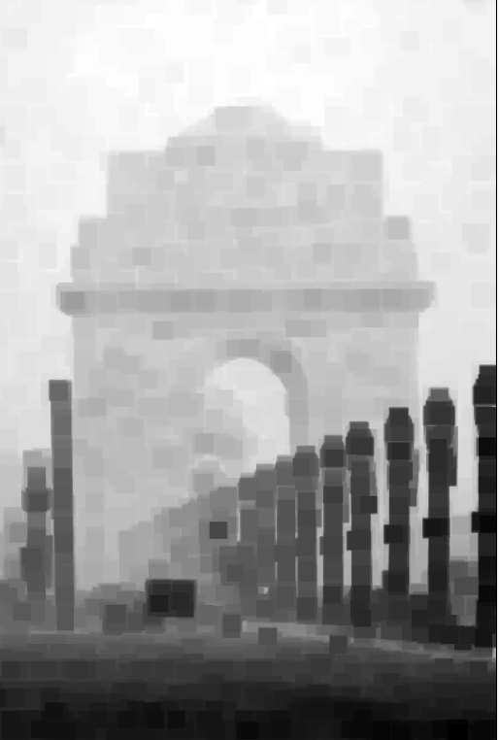
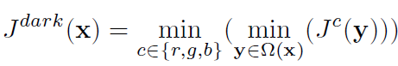
Concepts Used
Dark Channel of an Image:
For an image J, we define the dark channel as:
where Jc is a color channel of J and Ω(x) is a local patch centered at x.

Slide 6
Concepts Used
Dark Channel of an Image:
The basic observation is that on haze-free outdoor images, most of the non-sky patches, at least one color channel has very low intensity at some pixels. The low intensities in the dark channel are mainly due to:
Dark objects, shadows of trees and rocks.
Colorful objects Ex- green, red, yellow, blue
Objects with greyish color (i.e., having equal intensity across the three channels) are rarely found outdoors.
Since the natural outdoor images are usually colorful and full of shadows, it is reasonable to generalize the observation.

Slide 7
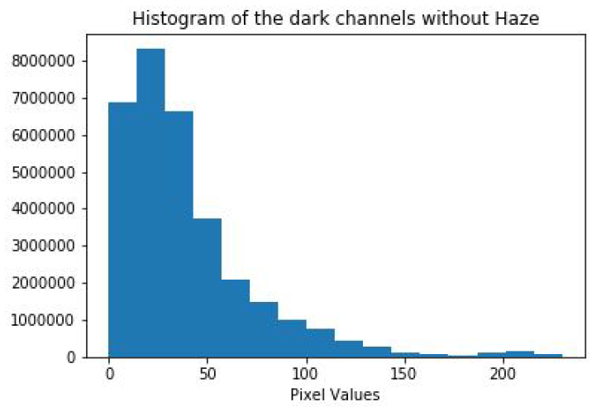
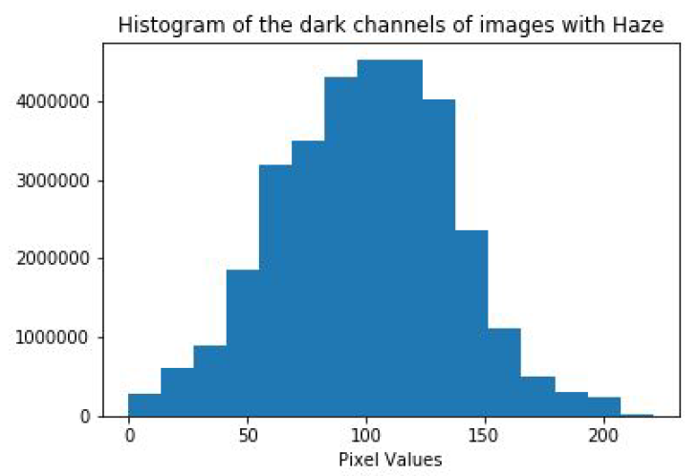
Concepts Used
Dark Channel of an Image:

Slide 8
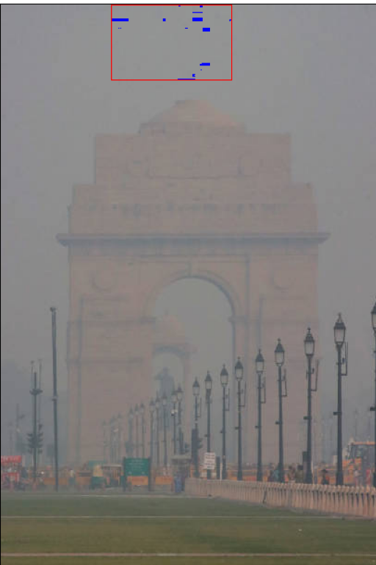
Concepts Used
Estimating Atmospheric Light:
The dark channel of a haze image approximates the haze denseness. We can use it to estimate the atmospheric light.
We pick the top 0.1% brightest pixels in the dark channel. These pixels are the most haze opaque. Among these pixels the pixel with the highest intensity in the Image is selected as the atmospheric light.
This method is better than picking the brightest pixel. Since, in images, the brightest pixel could be on white objects.

Slide 9
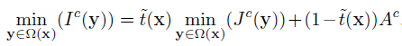
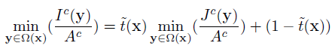
Concepts Used
Estimating the Transmission:
Taking min operation in the local patch on the haze imaging equation:

Slide 10
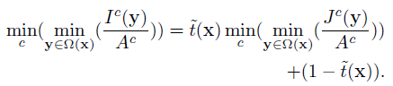
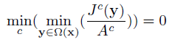
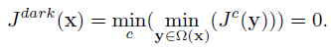
Concepts Used
Estimating the Transmission:
Then, we take the min operation among three color channels on the above equation and obtain:
According to the dark channel prior,

Slide 11
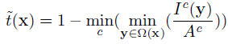
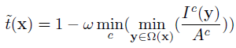
Concepts Used
Estimating the Transmission:
Hence we get:
Here, the second term on the right hand side can be calculated as the dark channel
of (I/A)
In general, the atmosphere has particles and there seems to be little haze when we look at far off objects. The presence of haze helps to perceive some depth. Hence, we can keep a small amount of haze for distant objects:
ω (0<ω<1) is a parameter.

Slide 12
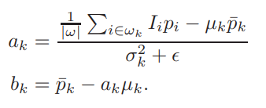
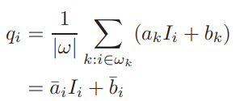
Concepts Used
Guided Filter:
There are some block effects since the transmission is not always constant in a patch. We refine the transmission map using guided filter. Guided filter is a type of edge-preserving smoothing operator, which filters the input image (Estimated transmission map) under the guidance of another image(Original image).
The filtered output q, as a function of the input image p and guidance image I is calculated as:

Slide 13
Concepts Used
Depth Map:
When the atmosphere is homogenous, the transmission t can be expressed as:
where β is the scattering coefficient of the atmosphere. This equation indicates that
the scene radiance is attenuated exponentially with the scene depth d

Slide 14
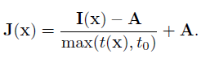
Concepts Used
Recovering the Scene Radiance:
We restrict the transmission t(x) to a lower bound t0, which means that a small amount of haze are preserved in very dense haze regions.

Slide 15
Concepts Used
Color Correction:
Color balance helps in color enhancement and contrast enhancement. Color balance stretches the values of the three channels R, G and B so that they occupy the maximal possible range [0,255] and provide us with some contrast.

Slide 16
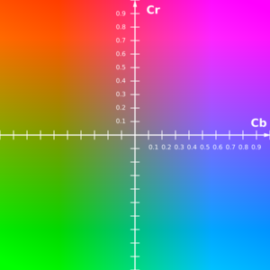
Concepts Used
Comparison with Histogram Equalization:
We compared the output from the Dark Channel method with basic histogram equalization performed on the Y channel of the images in the YCbCr color space.

Slide 17
Demonstration
Language Used: Python

Slide 18
Results
Hazy Image Dark Channel

Slide 19
Results
Atmospheric Light Estimated Transmission Map

Slide 20
Results
Transmission map after refinement with Guided Filter vs Original Transmission map

Slide 21
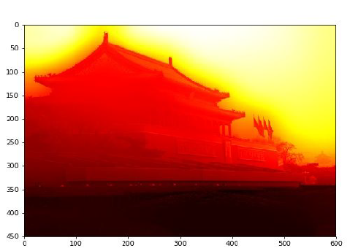
Results
Depth Map

Slide 22
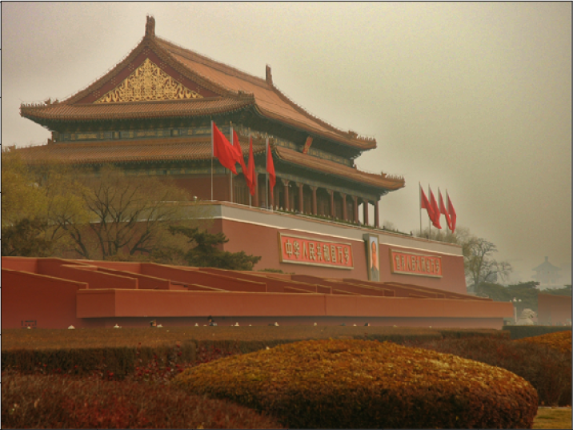
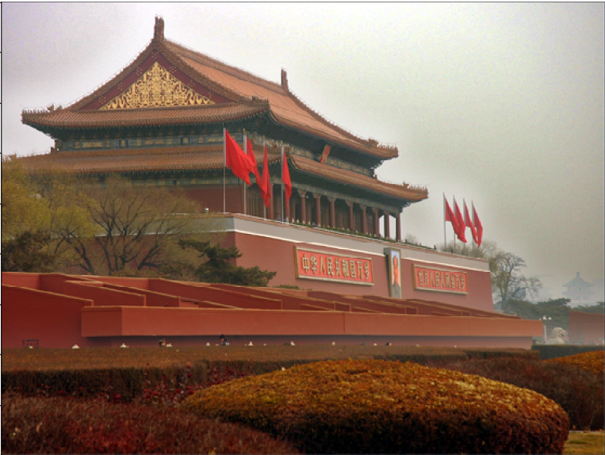
Results
Restored Image After Colour Correction

Slide 23
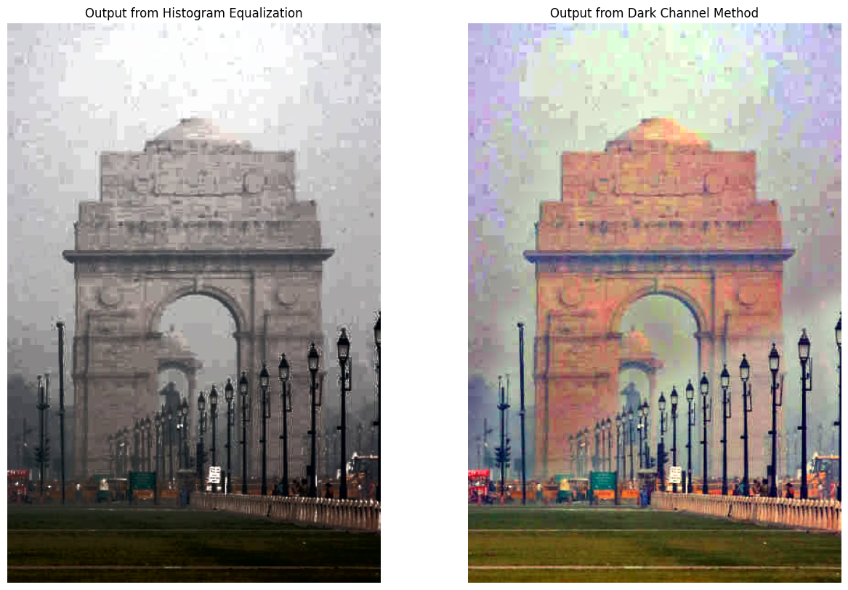
Results
Comparison with Histogram Equalization

Slide 24
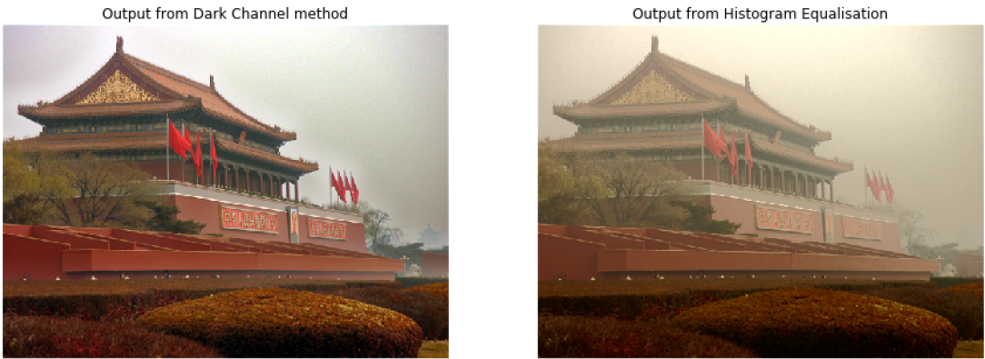
Results
Comparison with Histogram Equalization

Slide 25
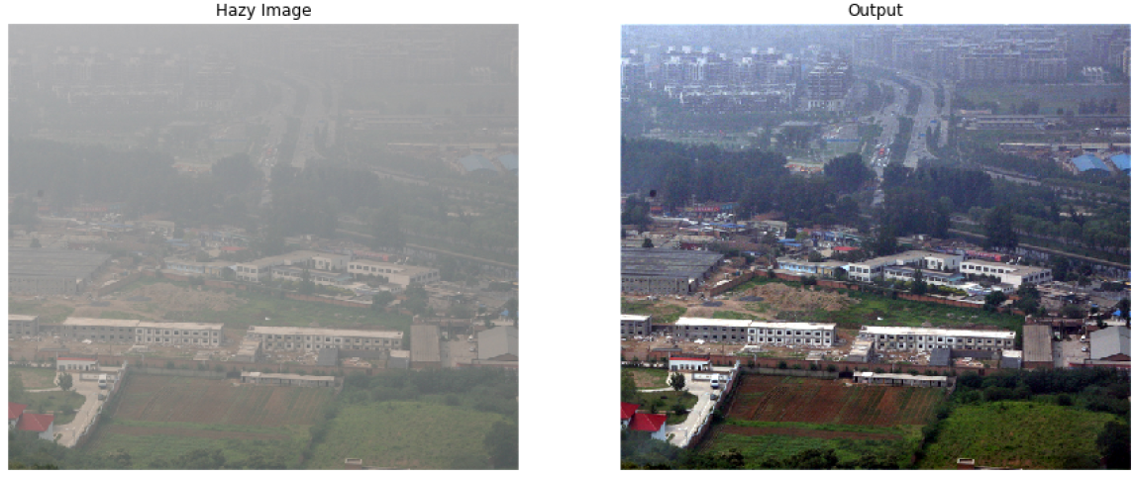
Results
Test Images

Slide 26
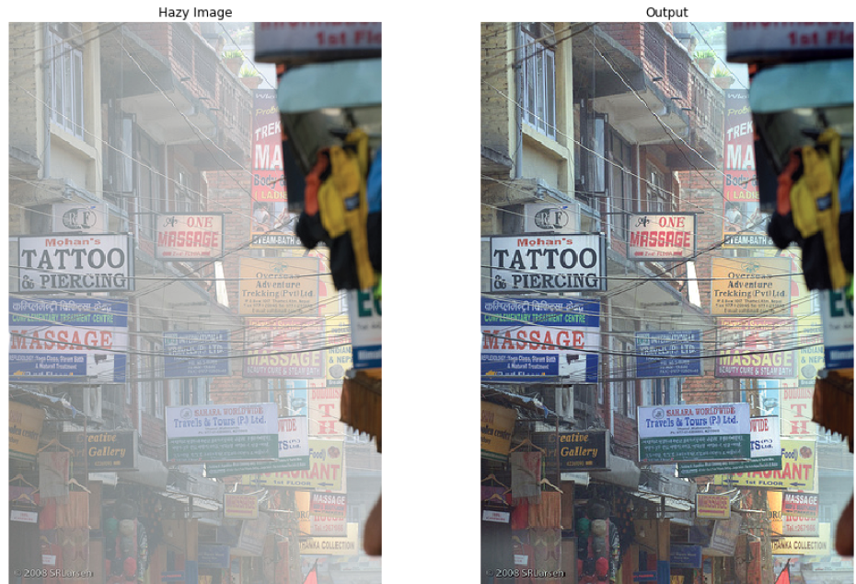
Results
Test Images

Slide 27
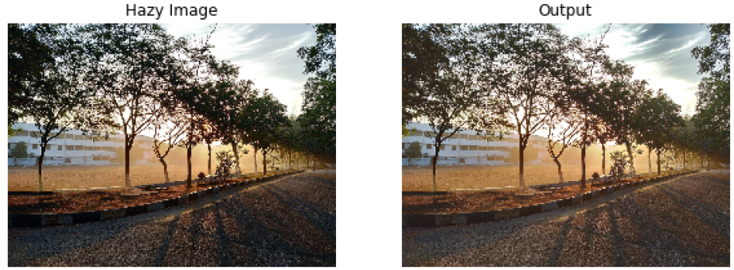
Results

Slide 28
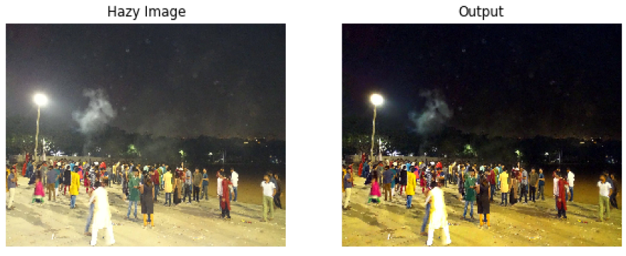
Results

Slide 29
Conclusion
The algorithm seems to perform really well on most outdoor images. It removes most of the haze from the images, only leaving out some when the haze is extremely thick.
Since the dark channel prior assumption only works when haze is the brightest object in the dark channel, the algorithm fails if there is a prominent white object/light in the picture that is brighter than the haze.

Slide 30
References
[1] K. He, J. Sun, and X. Tang, “Single image haze removal using dark channel prior”
[2] J. Pang, O. C. Au and Z. Guo, “Improved Single Image Dehazing Using Guided Filter”
[3] C. O. Ancuti, C. Ancuti, R. Timofte and C. D. Vleeschouwer, “O-HAZE: a dehazing
benchmark with real hazy and haze-free outdoor images”
[4] C. O. Ancuti, C. Ancuti, R. Timofte and C. D. Vleeschouwer, “I-HAZE: a dehazing
benchmark with real hazy and haze-free indoor images”
[5] N. Limare, J. L. Lisani, J. M. Morel, A. B. Petro, C. Sbert, “Simplest Color Balance”

